Slide 1
Chapter 1 Introduction to E-Commerce
7 hours

Slide 2
Contents
E-commerce
Definition and concepts
Defining E-business
Pure and Partial EC
EC Framework
Characteristics of EC
Benefits of EC
Role of internet and web in E-commerce
Limitations and barriers
Social networks and networking services
m-commerce
Concept
Scopes and attributes
Benefits
Location based commerce (l-commerce)
Location based services and applications

Slide 3
E-commerce Definition
Commerce is a division of trade or production which deals with the exchange of goods and services from producer to the consumer.
Commerce comprises the trading of something of economic value such as goods, services, information, or money between two or more concerned parties.
Electronic Commerce, usually called as E-commerce, refers to the buying and selling of goods and services over electronic systems/devices such as the internet.
E-commerce uses internet and other networks(intranet, extranet) to purchase, sell, transport, or trade data, goods or services.

Slide 4
Standard Definition
E-commerce is a methodology of business which addresses the need of business organizations, vendors and customers to reduce cost and improve the quality of goods and services while increasing the speed of delivery.
E-commerce refers to the paperless exchange of business information using the following ways:
Electronic Data Exchange (EDI)
Electronic Mail (e-mail)
Electronic Bulletin Boards
Electronic Fund Transfers (EFT)
Other network based technologies

Slide 5
What is E-business
Some still view e-business as the activities that do not include buying and selling over the internet.
In narrow perspective, e-business consists of collaboration and intra-business activities.
However, e-business has a broader scope than EC.
E-business relates to conducting all kinds of business online (not just buy or sell) such as servicing customers, collaboration with partners, delivery, advertisement and feedback, electronic transactions, etc.

Slide 6
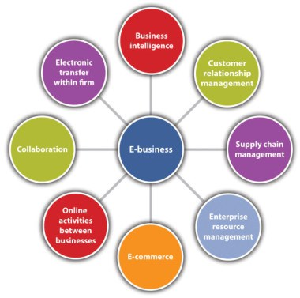

Slide 7
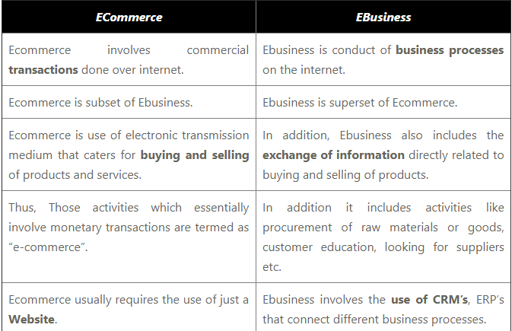

Slide 8
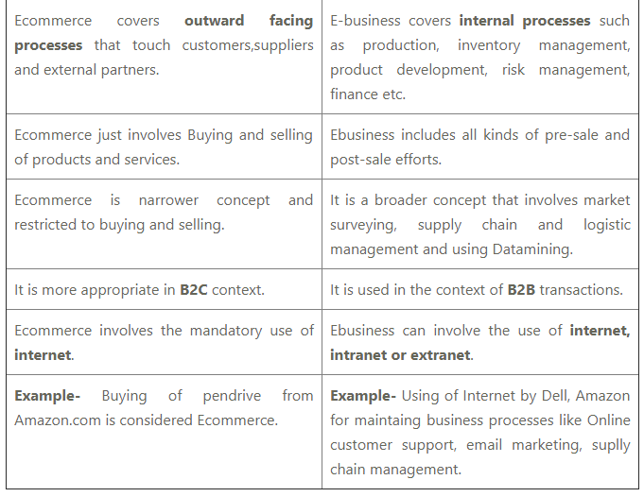

Slide 9
Pure vs Partial EC
EC can be pure or partial based on 3 attributes:
Ordering and Payments
Fulfillment of orders
Delivery to customers
If all activities are digital, then the related e-commerce is pure.
If no activities are digital, then the business has no e-commerce.
If some activities are digital and some are not, then the business has partial e-commerce.

Slide 10
Example of pure and partial EC
Pure EC
Buying an E-book
In-app purchases in games or mobile apps.
Buying and Selling of Mutual Funds
Partial EC
Order a laptop online which then gets delivered physically.
Buying book from sastodeal.
Ordering items from Daraaz.

Slide 11
Electronic Commerce VS Traditional Commerce
Traditional Commerce | Electronic Commerce
Face-to-face interaction | Interaction through electronic media
Printed and written documents exist | Digital invoices and receipts exist
Customization in transaction is very rare | Transaction or user pages can be customized
Communication by postal mail or telephone | Communication by e-mail or sms
Advertisement is manual or through TV, Radio | Advertisement is on web pages, sms, social media
Merchandise delivered immediately | Merchandise delivery takes 2 days on avg
Item exchange, refunds are tedious | Item exchange refunds are easy

Slide 12
Features of E-Commerce
Non-Cash Payment
24x7 Service Availability
Wider advertisement and marketing scope
Improved sales
Better support
Efficient inventory and order management
Improved communication
Window for customization

Slide 13
Advantages/Benefits of E-Commerce
Market expansion / Global Reach
Reduced cost for processing and distribution of goods
Reduces paperwork
Improves company brand and functionality
Better customer services
Simplification of business processes
Faster and efficient business transactions

Slide 14
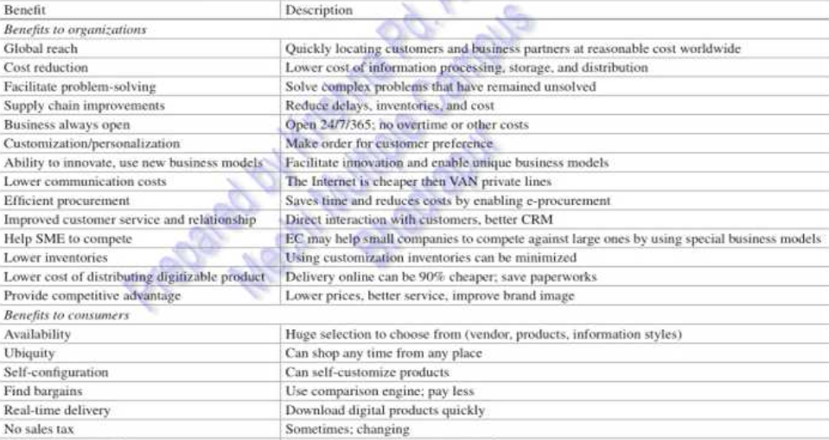

Slide 15
Disadvantages of E-Commerce (General)
Cost of implementation
User Resistance and Reach
Security and Privacy issues
Lack of touch for online shopping
Ecommerce applications not always work as intended
Internet access is inconvenient in various parts of the world
Digital divide

Slide 16
Disadvantages of E-Commerce (Technical)
System security is always vital aspect
Software development industry is always changing
Network bandwidth is not stable or available everywhere
Need of special hardware and software facilities for some business
Difficulty of integration of e-commerce application with existing application or databases
Hardware Software compatibility issue
Sometimes transactions are one-way; Roll back option might be unavailable.

Slide 17
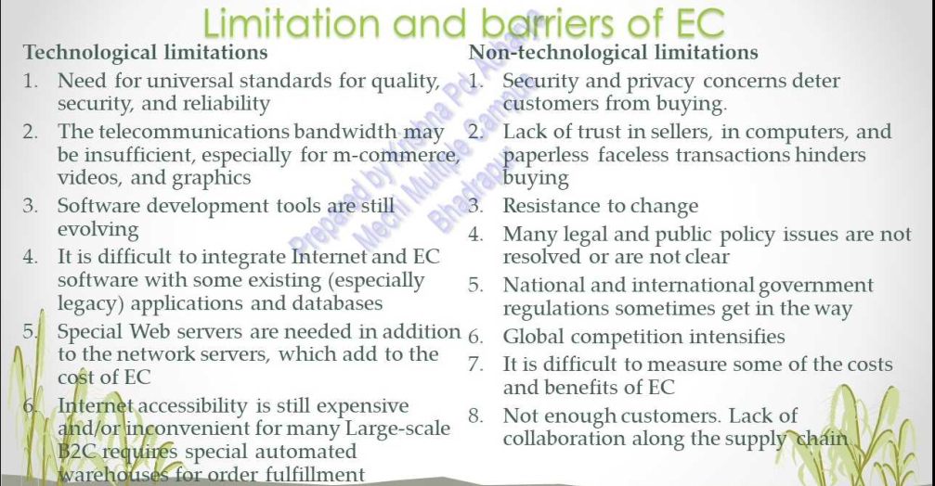

Slide 18
EC Framework
There are 4 levels/components of EC framework.
Base level (People)
(Related to Organization, Management, and Control)
Management

Slide 19
EC Framework
Intermediate level (Data and Infrastructure)
Common business service infrastructures (Smart Cards, Authentication, Payments, Catalogs)
Messaging and information distribution infrastructures (email, HTTP, FTP)
Multimedia content and network publishing infrastructures (HTML, WWW)
Network infrastructures (Internet, LAN/MAN/WAN, Intranet and Extranet, Telecom, Cable TV)
Interfacing infrastructure (Database, Customers, Applications)

Slide 20
EC Framework
High level (Technical standards and protocols)
People (Buyers, sellers, intermediaries, supports)
Policy (Public, legal, and privacy issues)
Technical Standards (Standards for documentation, security, networking protocols)
Organizations (Partners, Competitors, Association, Govt. Services )

Slide 21
EC Framework
Top Level (E-commerce Applications)
Procurement and Purchase
Stocks Jobs
Online banking
Online marketing and advertising
Home based shopping
Auctions
Travel and tourism
Online publishing

Slide 22
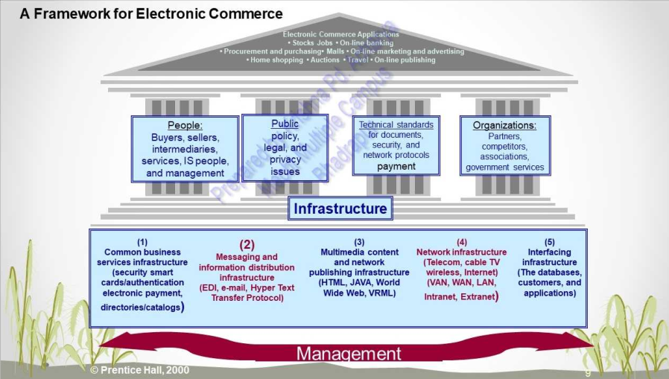

Slide 23
EC Framework in simple table
APPLICATION SERVICE LAYER
INFORMATION BROKERAGE AND MANAGEMENT LAYER
INTERFACE AND SUPPORT SERVICES LAYER
MESSAGING LAYER
MIDDLEWARE LAYER
NETWORK INFRASTRUCTURE LAYER

Slide 25
Role of internet in ecommerce
The internet provides a worldwide collection of networks, linked with each other to share information by using a common set of protocols.
Since internet is a large network of people and information around the world, it is an enabler for e-commerce as it allows businesses to showcase and sell their products and services online.
It gives potential customers, prospects, and business partners the access to information about these business houses, their products and services which might lead to purchase and sales.
The internet opens up opportunity for people all over the world to get linked inexpensively and consistently. Hence it is an important aspect for ecommerce.
Internet contains social networking sites, marketing houses, online banking institutions, shopping sites, etc.

Slide 26
Role of Internet (compact version)
There are may ways to use Internet in Business.
Buy and Sell.
Market Research.
Checking Customer Interest.
Advertising.
Online Shopping.
Online Services.
Online Banking.

Slide 27
1. Buy and Sell:
One of the basic uses of the Internet for businesses is to sell products and services.
Businesses create E-commerce websites to sell anything from cell phone contracts to books and CDs.
2. Research Competition:
Some businesses use the Internet to research competitors.
An Internet search on a competing company results in articles and news stories about the competition that may help a business owner prepare for changes in the industry.
3. Checking Customer Interest:
Business owners use the Internet to monitor customer purchasing trends and interests.
To discover what everyday people think about a particular product or service, business owners can visit online social networking sites and message boards.
Taking in this feedback helps business owners make their products better.

Slide 28
4. Advertising:
Businesses also use the Internet to find new customers through online advertising.
Offering text and banner ads on websites as well as informational pieces, the Internet allows advertisers to reach potential customers quickly and efficiently.
Pay-per click advertisements are distributed on Internet search engines and websites, allowing business owners to reach potential customers using search terms related to their business.
5. Online Shopping:
It is a form of electronic commerce which allows consumers to directly buy goods or services from a seller over the Internet using a web browser.
Consumers find a product of interest by visiting the website of the retailer directly or by searching among alternative vendors using a shopping search engine, which displays the same product's availability and pricing at different e- retailers.

Slide 29
6. Online Services:
A commercial service that provides access to services such as the Internet, e-mail, news, etc.
An online service provider may be a local, international, or global company who specializes in online services or allows you to connect to online services through their network.
7. Online banking:
It is also known as internet banking, e-banking or virtual banking, is an electronic payment system that enables customers of a bank or other financial institution to conduct a range of financial transactions through the financial institution's website.
The online banking system will typically connect to or be part of the core banking system operated by a bank and is in contrast to branch banking which was the traditional way customers accessed banking services.

Slide 30
Role of Web in E-Commerce
The World Wide Web is improving contact means, partnership, and production efficacy.
A major advantage is rapid communication and interaction among participants, with business leaders able to make intelligent moves and techniques much more promptly than in the previous years when internet was not yet widely used are:
1. Customers visiting business sites can make all necessary transactions using the internet without the hassle of going to the actual store.
2. They can even view and buy anything in that website 24 hours a day and 7 days a week.
3. Updates on order status and delivery schedule can also be known through the internet. Thus, the customer is well-informed about his purchase, from choosing the product to actually getting it.

Slide 31
4. Customers can view detail technical specifications of products even if they are miles away or separated by seas from the supplier.
Through this, customers can make more intelligent assessment of the products being sold. This is specifically applicable to products that involve intensive designing means such as for laboratory equipment or manufacturing facility machineries.
5. Customers can have a more personal connection with the business through the Internet and on the other hand, businesses can have continuous communication with the customer.
With the internet, making follow-ups on pending orders has become easier. Moreover, even payment of orders has become simple, secured and trouble-free through the use of the World Wide Web.

Slide 33
Classification of EC
E-commerce is divided into 4 main categories:
Business to Business (B2B)
Business to Consumer (B2C)
Consumer to Consumer(C2C)
Consumer to Business(C2B)

Slide 34
Business-to-Business(B2B) E-Commerce
Business-to-business (B2B) ecommerce describes online transactions between business houses.
B2B e-commerce is simply defined as e-commerce between companies.
A website following the B2B business model sells its products to an intermediate buyer who then sells the product to the final customer.
For instance, a wholesaler places an order from a company's website and after receiving the consignment, sells the end-product to the final customer who comes to buy the product at one of its retail outlets.
Example: Intel selling microprocessor to Dell.

Slide 35
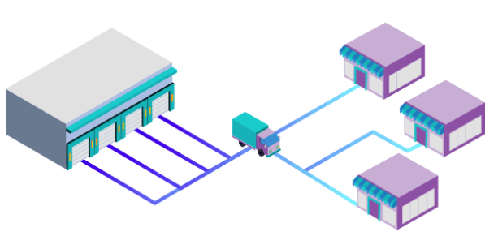

Slide 36
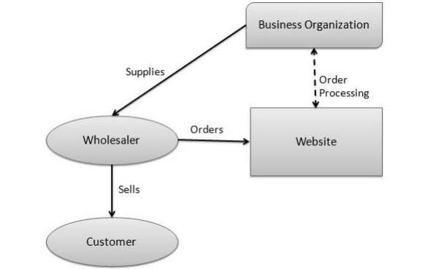
Supplier
(Business org #2)
B2B
Wholesaler
(Business org #1)

Slide 37
Advantages
Compared to the other business strategies, the B2B e-Commerce business model has more market stability.
B2B sectors grow gradually and can adapt to various complex market conditions.
Helps to strengthen the online presence and business opportunities and get more potential clients and resellers.
An improved supply chain management process along with a collaborative approach.
Lower costs for the businesses.
With an integrated data-driven approach, you can calculate detailed sales statistics.

Slide 38
Disadvantages
Limited Market
A risky venture for small and medium e-commerce businesses.
majority of the purchase decisions involve a lengthy process as there are two businesses involved.
Compared to the other models, consumers have more decision making power than sellers in the B2B business model.
Hence, they may demand customizations, impose specifications and try to lower price rates.

Slide 39
Business-to-Consumer (B2C) E-Commerce
A B2C business model sells its products directly to a customer.
A customer can view the products shown on the website. The customer can choose a product and order the same. The website will then send a notification to the business organization via email and the organization will dispatch the product/goods to the customer.
It is the second largest and the earliest form of e-commerce.
The more common B2C business models are the online retailing companies such as Amazon.com, Drugstore.com, etc.
B2C e-commerce reduces transactions costs (particularly search costs) by increasing consumer access to information and allowing consumers to find the most competitive price for a product or service.

Slide 40
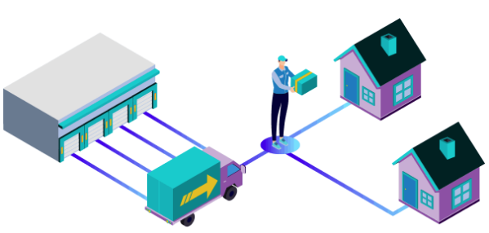

Slide 41
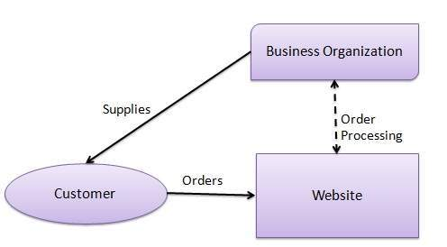

Slide 42
Advantage
Expansion of market place to global
Cheaper electronic transaction
Time flexibility
Reduces operational costs
Less investments
Easy and comfort shopping
No hassles of middlemen
Disadvantage
Low conversion rates
Technical Glitches
High risks
More competition
Security threats

Slide 43
Consumer-to-Consumer(C2C) E-Commerce
C2C business model helps consumers to sell their assets like residential property, cars, motorcycles, etc., or rent a room by publishing their information on the website.
Website may or may not charge the consumer for its services.
Another consumer may opt to buy the product of the first customer by viewing the post/advertisement on the website.
Hamrobazar.com falls under this category.

Slide 44
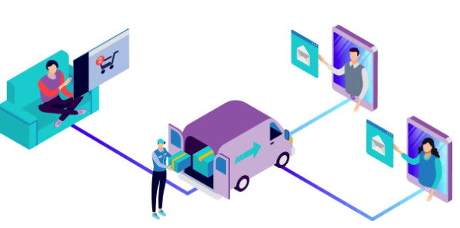

Slide 45
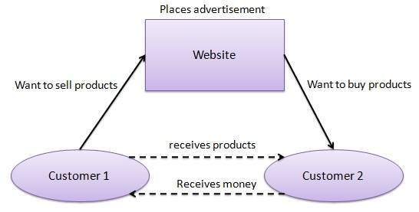

Slide 46
Advantage
Sellers can post their goods over the internet cheaply compared to the high rent space in a store.
The lower expenses lead to smaller, yet profitable customer base.
Being in a community of similar interest where buyers and sellers come together leading to more chances of goods and services being sold.
Another benefit is that many small businesses can obtain a higher profitability over a C2C compared to a physical store because of the reduction of overhead costs when conducting an e-business.

Slide 47
Disadvantage
It is the least safe and unreliable platform to conduct business.
Sometimes buyers and sellers are not accommodating to each other when transactional information is needed.
These types of sites are known for scams, swindles, and people with ill-business intentions.
When things go wrong on C2C e-commerce communities, people can easily spread their stories across the internet which effectively is Word-of-Mouth (WOM) advertising

Slide 48
Consumer-to-Business(C2B) E-Commerce
A consumer approaches a website showing multiple business organizations for a particular service.
The consumer places an estimate of amount he/she wants to spend for a particular service.
For example, dairy product sold to community market by the milkman.
A business organization who fulfills the consumer's requirement within the specified budget, approaches the customer and provides its services.
Another example of this model also includes the designers who present several proposals for a company logo and where only one of them is selected and effectively purchased.

Slide 49
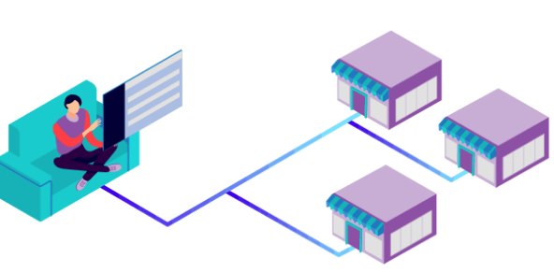

Slide 50
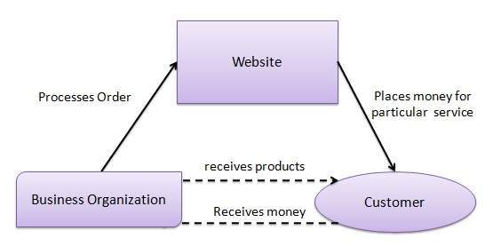

Slide 51
Advantages
Papal set up directly for this reason.
Broader market.
Eliminates intermediary.
Constantly changing, updating.
Always there so that consumers can use it whenever they want.

Slide 52
Disadvantages
No quality control
No payment guarantee
Hard to pay for using cheques, ATM, cards, etc. but in future this is likely to change

Slide 54
Social network and social network service
A social networking service (also social networking site or social media) is an online platform which people use to build social networks or social relationships with other people who share similar personal or career interests, activities, backgrounds or real-life connections.
A social networking service (SNS) is an online vehicle for creating relationships with other people who share an interest, background, or real relationship.
Social networking service users create a profile with personal information and photos and form connections with other profiles.

Slide 55
Successful specialized SNS include YouTube, Instagram, Twitter, LinkedIn, Reddit, Snapchat, Tumblr, Pinterest, and TikTok. SNS profiles are very popular across the globe.
The social networking service business model is based on online advertising, either through targeted advertising that utilizes an individual's personal information, search habits, location or other such data, or by selling the personal information to third parties.
Mobile technologies, such as smartphones and tablets, have helped the growth of social SNS adoption and use.

Slide 56
Social Networking Service Characteristics
Driven by User-generated contents, such as photos, videos, and posts.
Ability to connect individuals from all over the world.
Generally free-to-use.
Business model is based on breadth of membership.
Help in forging and developing relationships between people who share a profession or business network.
They may be used to help individuals find information, products, services or resources that are relevant to them.

Slide 57
Pros
People can use social media to connect with others, including friends, family, and those with the same interests.
Companies can use social networks to reach new and existing clients, and to build and improve their brand name.
Corporations that use social media can connect with their clients and demonstrate the level of their customer service.
Cons
Social media helps spread misinformation.
Criticism of companies can spread quickly, causing problems for their public relations departments.
Advertising and maintaining a corporate profile on social media can be costly.

Slide 59
M-commerce: concept, scope, Attribute, Benefits
Mobile commerce, also known as m-commerce or m-commerce, is the use of wireless handheld devices like cellphones and tablets to conduct commercial transactions online, including the purchase and sale of products, online banking, and paying bills.
It uses gadgets, such as mobile cellphones and tablets, to facilitate online banking, payment of bills, purchases and sales of good and services, and other types of financial transactions.
M-commerce is a part of electronic commerce, which implies wireless online shopping with the help of handheld devices (smartphones and tablets).
The rapid growth of mobile commerce is attributed to the growth of wireless communication networks, mobile commerce apps, and improved device infrastructure.

Slide 60
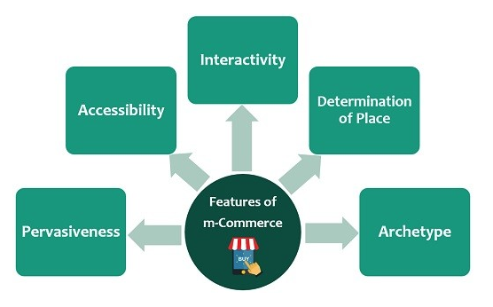
Features of M-commerce

Slide 61
Pervasiveness: The term pervasiveness defines the easy accessibility of information in real-time, i.e., it is an easier way for the users to fulfill their desired products query.
Accessibility: Devices like mobile and tablets are always nearby, the user can access it according to his convenience from anywhere.
Inter-activity: Mobile system allow for fast and easy interactions. i.e. the customer will directly search for a desired category of product, there is no need for viewing all the categories of products.
Determination of Place: Targeting customers with mobile promotions within a defined geographical space.
Archetype: Creation of the services that customize the end-user experiences.

Slide 62
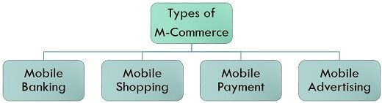
Types of M-commerce
These are the majorly used types of M-commerce:

Slide 63
Mobile banking:
Mobile banking is an electronic medium of managing and making bank transactions via-a mobile device. Here, a customer has a bank account in a respective bank can handle their bank account as well as view his/ her banking details through mobile apps.
Mobile shopping:
Mobile shopping is what we call “online shopping” in general terms, i.e., purchase made through various applications online such as, purchase of the book from amazon or purchase of a item from Daraz.
Mobile payment:
Online transaction payment such as buying airplane tickets, movie tickets, bill payments through mobile phones by way of various gateways and applications such as Phone Pay, E-sewa, is known as Mobile payment.
Mobile advertising:
Mobile advertising is a way of advertising through SMS, mobile web posters, push-up notifications.
Companies use this service to promote their products and services by giving their ads in between the contents generally searched by the users.

Slide 64
Advantages of M-commerce
1. Access Anytime Anywhere
Mobile commerce together with wireless communication technology and wireless broadband internet access, keeps the mobile user connected with the internet while travelling across the globe.
This anytime/anywhere internet access makes business transactions more flexible and customer communications more efficient, which in turn improves the productivity of the company and increases customer satisfaction.
Handheld devices allow users to continuously send/receive electronic mail, download news alerts, stock prices and receive weather updates.
The round the clock (24 x 7) internet availability benefits many users to conduct business transactions from their homes or from any other place while on the move and at any convenient time.
Thus m-commerce offers greater mobility and flexibility to mobile users in performing business transactions using their handheld mobile devices.

Slide 65
2. Cost-effective
The costs of transactions using mobile devices are relatively low.
The time-critical business data, such as reports, photographs, etc. can be captured and transmitted easily from the mobile devices without involving any bulky expensive equipment.
E.g. Customer support, sms-based payments, micro-payments, etc. can be performed using mobile phones.
In case of mobile billing, users can pay for electricity bills, telephone bills, petrol, grocery, etc. through their mobile phones.
The payments made in the mobile phones for such items will appear as part of their mobile phone bills, thus eliminating the need' for a third party payment mechanism such as, credit cards. This reduces the cost of payment to a large extent.

Slide 66
3. Personalized Service
Mobile commerce offers a number of personalized services to the mobile users depending on their various requirements and purposes. The digital cellular technology can monitor the location of user performing mobile transactions.
Knowledge of the user's location may be used to deliver timely and useful contents such as product availability and discount information to the potential customer.
Timely information, such as flight schedules and flight availability can be delivered to the user at the last minute.
Delivery of time critical as well as emergency information, SMS- based notifications and alerts can be easily made if the location of the user is tracked.
Delivery of regional maps, driving directions and online directories are also possible if the location of the mobile user is known.
Another major advantage-of location tracking is that, in criminal investigation, the location of the mobile user can be monitored and recorded as part of the investigation process.

Slide 67
Disadvantages of M-commerce
Mobile Device Limitations
Small screen size: Mobile devices have smaller screen size (of the order of 2 by 3 inches) and poor resolution which makes them inconvenient for browsing applications.
Low speed processor: Most mobile devices come with low-powered processors with much lower processing speed compared to sophisticated processors (i.e. core 2 duo or i-core series) used in desktops or laptops. Such low speed processors restrict the download speed in most mobile commerce applications.
Small memory capacity: The mobile devices do not have large storage space. The memory capacity in mobile devices is in the order of 5 GB to 10 GB compared to 2 TB or higher used in desktops/laptops. So, it is difficult to store large video files in mobile devices for future use.
low power backup: Mobile devices use batteries as their power supply. Normally, power for a mobile device lasts up to 2-3 days, depending on the size of the device.

Slide 68
(2) Wireless Network Limitations
Mobile commerce depends on wireless networks which are usually of lower speed compared to wired networks.
In many cases, wireless networks offer one-fourth speed of standard wired network.
Also, most wireless networks are more common in urban areas and some of the rural areas might not have wireless communication facilities. So online mobile services may become unavailable in some rural areas, and thus the popularity of mobile services may be suffered
(3) Bandwidth Restrictions
A major disadvantage of mobile commerce is the bandwidth limitation, which imposes a limitation on speed of operation in various m-commerce applications.
Wireless networks use frequency spectrum to transmit information across the network. Regulatory bodies control the use of available frequency spectrum and allocate the spectrum to various mobile operators.
The limited availability of bandwidth to various mobile operators in turn restricts the data rate in mobile commerce applications.

Slide 69
(4) Security Issues
Another concern that is often raised in connection with mobile commerce is the security issue.
Mobile devices are more vulnerable to theft, loss and mishandling.
Special care must be taken to ensure that the security and privacy of the mobile customer are not compromised at the event of loss of a mobile device. This includes not storing sensitive information in the mobile devices and changing/locking of PIN (password fast and simple at the time of need.
Mobile commerce employs public wireless networks for transmission of signals which can be easily intercepted by hackers for capturing/ altering stream of data travelling through the wireless medium.

Slide 70
Attributes
The attribute of mobile commerce are
Mobility
Mobile computing and m-commerce are based on the fact that users carry a mobile device anywhere they go.
Mobility implies portability. Therefore, users can initiate a real-time contact with other systems from wherever they happen to be if they can connect to a wireless network.
Broad Reach
In mobile computing, people can be reached at any time.
Of course, users can block certain hours or certain messages, but when users carry an open mobile device, they can be reached instantly.
They create the following five value-added attributes that the development of m-commerce: ubiquity, convenience, instant connectivity, personalization, and localization of products and services.

Slide 71
Ubiquity. Ubiquity means being everywhere, especially at the same time. It is facilitated by wireless computing. Given that Wi-Fi access is available in more and more places, and that about half of all mobile phones are smart- phones, we have easier ubiquity.
Convenience and capabilities. Having a mobile device increases the convenience of communication. The functionality and usability of mobile devices are increasing, while their physical size remains small and the cost is affordable. Unlike traditional computers, mobile devices connect to the Internet almost instantly.
Interactivity. Mobile systems allow for fast and easy interactions (e.g., via Twitter, tablets, or smartphones).
Personalization. Mobile devices are personal devices. While several people may share the same PC, a specific mobile device is usually used by one person.
Localization. Knowing where a user is physically located in real time provides an opportunity to offer him or her relevant mobile advertisements, coupons, or other services. Such services are known as location-based m-commerce.

Slide 72
Fast Processing
It allows the user to process a transaction fast.
Not only does the customer receive his item almost instantly via download, e-mail or another form of electronic delivery, the business owner receives payment for his product or service more quickly compared to traditional methods.
The customer must set up a payment option, such as a credit card or an agreement to pay using a specified account, to process the payment immediately before downloading the item.
Reduced Business Costs
Mobile commerce also helps reduce costs for the seller. For paying a separate office space, overhead costs or employees.
In some cases a small business owner who sets up a mobile commerce operation doesn't need an office at all.
The seller can monitor sales online or by receiving statements from a processing service.
The main expense for this type of business owner is advertising to disseminate information on how users can access the product or service.
The lowered cost allows the business owner to take advantage of a higher per-sale profit. He also can offer the product at a lower price compared to delivery in other formats.
Little Need for Maintenance
It requires very little maintenance from the seller.
The owner sets the product up for mobile delivery one time and then receives payment for sales automatically.
From time to time, he may need to perform a few maintenance duties, such as correcting a technology error or updating the product, but overall it is a selling format that requires very little management compared with other selling strategies.

Slide 73
Scope of m-Commerce
Mobile Content Delivery
Mobile Customer Services
Mobile Marketing and Advertisement
Mobile Enterprise-level Applications
Mobile Governance Services

Slide 74
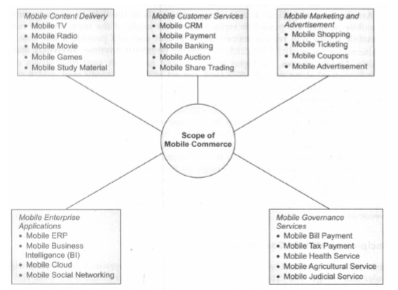

Slide 76
Location based L-commerce, L-commerce Infrastructure, location based service and Application
Location-based commerce is an evolution of mobile commerce that leverages the known location of the consumer to drive contextual engagement with mobile shopping applications relative to a known location or retail store.
The combination of GPS, application multitasking, and push notification technology
eBusiness executives can leverage to deliver tightly integrated multichannel promotions, offers, and services directly to their customers at the right time and in the right place.
Location-based commerce (l-commerce), or LBC, refers to the use of location-finding systems such as GPS-enabled devices or similar technologies (e.g., triangulation of radio- or cell-based stations) to find where a customer with a mobile device or an object is located and provide relevant services, such as an advertisement or vehicle route optimization.

Slide 77
Location-based services use real-time geodata from a smartphone to provide information, entertainment or security.
Some services allow consumers to "check in" at restaurants, coffee shops, stores, concerts, and other places or events. Often, businesses offer a reward – prizes, coupons or discounts – to people who check in. Google Maps, Foursquare, GetGlue, Yelp and Facebook Places are among the more popular services.
Location-based services use a smartphone's GPS technology to track a person's location, if that person has opted in to allow it. After a smartphone user opts in, the service can identify their location down to a street address without the need for manual data entry.
Sellers get the opportunity to advertise and provide or meet a customer’s needs in real time.

Slide 78
L-commerce involves context-aware computing technology. For images, search Google Images for “location-based commerce.”
L-commerce offers convenient services to consumers such as connections with friends, the ability to receive relevant and timely sales information, safety features (e.g., emergency assistance), and convenience (a user can locate what facility needed is nearby without consulting a directory or a map).
In essence, LBC is the delivery of m-commerce transactions to individuals who are in a known specific location, at a specific time.
Smartphones and tablets with location tracking that allows various apps to use the information of the people for social commercial uses.

Slide 79
Basic Concepts in L-Commerce
Location-based m-commerce mainly includes possible activities, all done in real time:
Location: Finding where a person (with a smartphone) or another mobile device or a thing (e.g., a truck) is located
Navigation: Finding and illustrating a route from one location to another(e.g, Google Maps)
Tracking: Monitoring the movements and whereabouts of people or objects (e.g., a truck, airplane)
Mapping: Creating maps of certain geographical locations with super imposed data if needed( e.g., GIS, Google Maps)
Timing. Determining the arrival or departure time of something at a specific location (e.g., arrival of a bus to a specific bus stop or an airplane to an airport)

Slide 80
Technology used in L-commerce
A mobile device communicates with other devices and hubs to function. That communication can be with satellites, routers, towers or anything else.
Because the mobile device is pinging off of multiple communication hubs, its precise location can be triangulated.
The most common are GPS, RFID, Wi-Fi and cellular.
GPS(Global Positioning system) :
The Global Positioning system is an array of satellites that exist solely to help find things across the planet.
Any device with a GPS receiver (which includes most smartphones) can ping the satellites with that receiver. This will cause it to communicate with at least four satellites, and the satellites can compare the signal delay to pinpoint where the signal originated. This allows your phone to know exactly where you are and provide turn-by-turn navigation.

Slide 81
Wi-Fi:
Wi- Fi location tracking is a bit different from other methods.
Typically, a device will only connect to one Wi-Fi network at a time. This eliminates the possibility of triangulation.
Instead, IP addresses are used for this form of location tracking. Every network has a physical IP address that allows the greater internet to know where it is.
This is necessary to accurately send information across internet infrastructure. When your phone connects to a Wi-Fi network, it pairs with the physical IP of that network. That allows location services to know your current address.
Cellular:
Cellular tracking works much like GPS.
Instead of connecting to satellites, though, your device is connecting to cellular towers.
Generally speaking, you will be in range of at least two towers, and that is enough for the system to use triangulation to find your location.

Slide 82
QR codes
QR tracking is closer to Wi-Fi in principle. When a dynamic QR code is scanned, it logs information related to the scan. When the QR code is established, its physical location can be recorded. That location can then be tagged anytime the code is scanned.
RFID
RFID tracking is effectively a combination of these other methods.
The RFID scanner typically has a static location. By pinging off of other networks, the location of the scanner can be logged. When the RFID scanner is activated, it can tag its location when it records the access. This can be used to identify the location of the device accessing the scanner.

Slide 83
Uses of location-based services
Companies have found several ways to use a device's location:
Store locators. Using location-based intelligence, retail customers can quickly find the nearest store location.
Proximity-based marketing. Local companies can push ads only to individuals within the same geographic location. Location-based mobile marketing delivers ads to potential customers within that city who might actually act on the information.
Travel information. An LBS can deliver real-time information, such as traffic updates or weather reports, to the smartphone so the user can plan accordingly.
Roadside assistance. In the event of a blown tire or accident, many roadside assistance companies provide an app that allows them to track your exact location without the need for you to give directions.
Mobile workforce management. For logistics-dependent companies that employ individuals out in the field or at multiple locations, an LBS allows employees to check in at a location using their mobile device.
Fraud prevention. An LBS creates another level of security by matching a customer's location through the smartphone to a credit card transaction. Tying the smartphone's location to a credit card allows you to flag transactions made across several geographic locations over a short time.

Slide 84
L-Commerce Infrastructure
The components depend on the applications. However, the following conditions usually exist:
Location finder (positioning) component: A GPS (or other device) that finds the location of a person or a thing.
Mobile Positioning Center: This includes a server that manages the location information received from the location finder.
User: The user can be a person or thing(e.g., a vehicle).
Mobile devices : The user needs a mobile device (e.g., a smartphone) that includes a GPS or other feature that locates the location (position) of something or someone.
Mobile communication network:The network(s) that transfers user requests to the service providers and then transmits the reply to the user.

Slide 85
Service or application providers. Providers are responsible for servicing a user’s request. They may use applications such as GIS.
Data or content provider. Service providers usually need to acquire (e.g., geographic, financial, or other data) in order to provide a reply to requests. Data may include maps, coupons, and GIS information.
Geographical information system (GIS). This includes maps, location of businesses, and more.
Opt-in application. In the United States and some other countries, LBS can be used only with people’s permission (opt-in). This requires an additional software app.

Slide 86
Here is how the LBS works
The user expresses his or her wish by clicking on a function(e.g. “find me the nearest gas station”).
The mobile network services finds the user is located using satellite and GPS.
The request is transferred via a wireless network to the application service provider software that activates a search for the needed data.
The server goes to a database, to find, for example, the nearest requested business and check if it is open , what it serves and so forth.
Using GIS, the service delivers the reply to the user, including a man and driving direction if necessary.

Slide 87
